Slide 1
Network Optimization Project
Mfg Enhancements

Slide 2
Change/Add | NOP UI | NOP Query Change | NOP DB | Comments
Add WWAN | Customer Section | Query DSCD as the source and then get the name | NOP Delivery table – add WWAN and WWAN name | Only used as a filter
Mfg Bldg | Sites – ensure screen edits are correct | Remove code checking field length of 3 get values from mfg bldg col. go to LMA and get coords. | Fields exist in NOP Delivery Data Table | July 18th is go-live for SAP mfg bldg project
Mfg Plant | Sites – ensure screen are edits are correct | Remove code checking field length of 4 get values from mfg plant col. | Fields exist in NOP Delivery Data Table
Supplier ID | Supplier – ensure screen edits are correct | DSCD will contain the vendor Key id – will need to join to vendor master (CMD schema) to get additional data. This field is only populated in DSCD when the part is PUR. | Need to add vendor ID and Name to Delivery Data and vendor Key ID | Do we need checkbox to pull additional supplier data? May require new vendor table in GSC.
Commodity Codes |  |  |  | Keep Comm code on UI w/no edits and will decide later if needed.
Mfg Filters |  |  |  | Determine what filters should be included in mfg section
BOM Number |  |  | Add to NOP BOM table | SAP and TED project IP to include in the ADR feed – July 27th target
BOM Records |  | Change query to limit to FG BOM level 1 only |  | Status?
Weights |  | Extract weights from new table in SRS using OIS sales org, part key id and plant (ship from or mfg? | Add new fields for part weight and UOM | Which wt and UOM needed from SRS

Slide 3
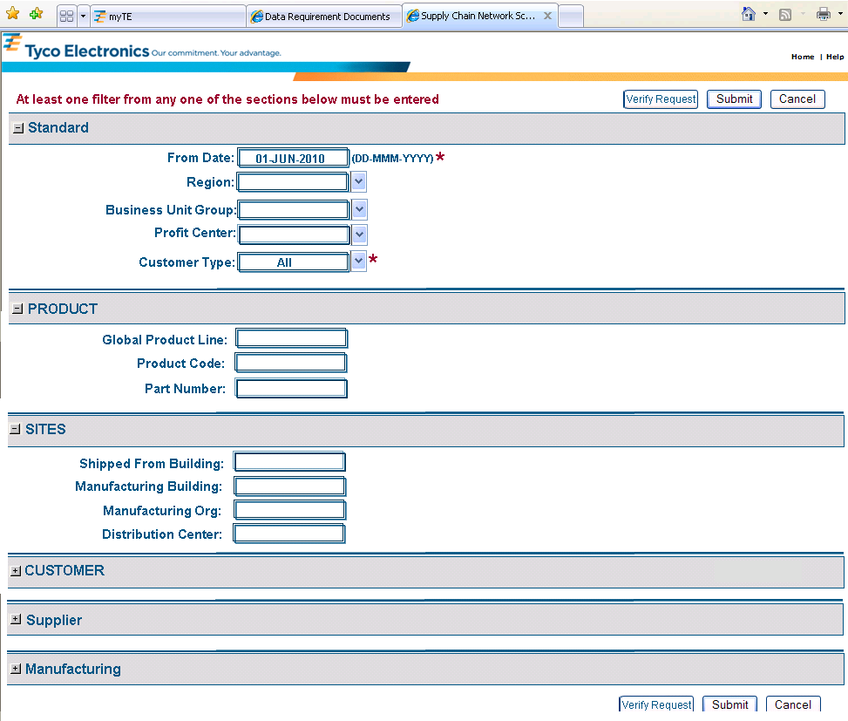
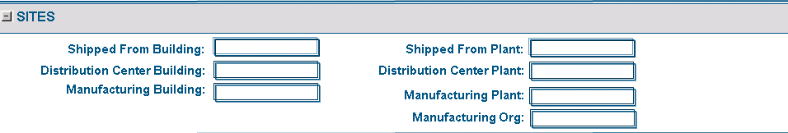
Supply Chain Network Optimization Projects
BOM
Mfg Bldg and Plant will now be available in DSCD Shipments.
Even if a mfg bldg or plant is not part of the filters we should extract them and populate them in the NOP Delivery table. All of the columns currently exist in the NOP Delivery table.
Need to ensure the UI edits are correct and change the query – today it may be looking at one field and if 3 pos it is a bldg and if 4 it is a plant whereas there will be a col in OIS for both individually.
Delete a Project

Slide 4

…Continued
Customer
and
Shipped to Customer Accts:
Worldwide Acct:
Industry Code:
Allow multiples separated by commas
No combinations – can only enter values in one of the boxes
Only one WWAN can be entered; must enter full
10 digits. This field is already stored on the DSCD OIS table. WW_ACCOUNT_NBR_BASE (8 byte) and WW_ACCOUNT_NBR_SUFFIX(2 byte)
Supplier
and
Supplier ID:
Commodity Code:
Source Supplier ID will be on the DSCD shipment record, this section
Would be used as a filter. Do we need a checkbox to include supplier data?
What would that data be?
Would queries be done by Major Commodity Codes?
Multiple CC could be entered - separated by commas
No combinations – can only enter values in one of the boxes
Manufacturing
Now that we will have mfg bldg/plant on DSCD – we will be able to get the mfg data. We should include a checkbox to include mfg data (or not) like we did for BOM. But are there any fields that we should add in this section to filter on for mfg data?
  Work Centers?
  Primary Process and Alt Processes?
Should we include all filters (if a mfg bldg and a part was entered – only pull those mfg records?
Verify Request

Slide 5
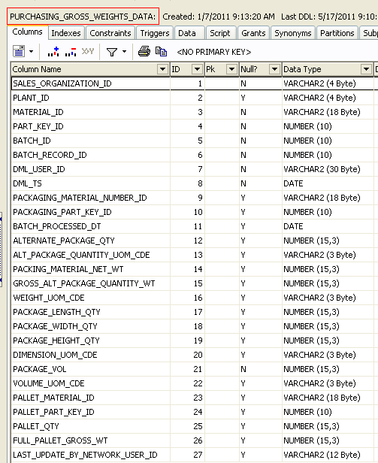
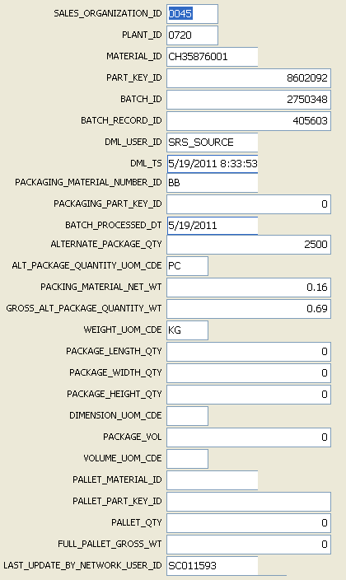
WEIGHTS RECORD LAYOUT
EXAMPLE WEIGHTS RECORD
NEW WEIGHTS TABLE INFO

Slide 6
select
PV1.PLANT,
PV1.MATERIAL_NUMBER as finish_prod,
PV1.MATERIAL_NUMBER as parent_prod,
1 as quantity
--, mid(RO1.WORK_CENTER,1,1) as WC_group
, substr(RO1.WORK_CENTER,1,1) as WC_group --mid is same as substr
/*, shed_hours([WO1].[FORMULA_FOR_PROCESSING_TIME]
,[WO1].[STD_VALUE_KEY]
,[RO1].[UNIT_OF_STAND_VALUE_1]
,[RO1].[UNIT_OF_STAND_VALUE_2]
,[RO1].[UNIT_OF_STAND_VALUE_3]
,[RO1].[UNIT_OF_STAND_VALUE_4]
,[RO1].[UNIT_OF_STAND_VALUE_5]
,[RO1].[STANDARD_VALUE_1]
,[RO1].[STANDARD_VALUE_2]
,[RO1].[STANDARD_VALUE_3]
,[RO1].[STANDARD_VALUE_4]
,[RO1].[STANDARD_VALUE_5]
,[RO1].[BASE_QUANTITY]) as shed_run_hours*/
,101 as shed_run_hours --sub until find shed_hours
,'1' as routing_level
from
ROUTING_OPERATIONS_V RO1, WORK_CENTER_HEADERS_V WO1,
(
select P2.MATERIAL_NUMBER, P2.PLANT,P2.ALT_BOM,P2.DETAIL_PLANNING_GROUP,P2.DETAIL_PLANNING_GRP_CNT
from
( select MATERIAL_NUMBER, PLANT, min (PRODUCTION_VERSION) as min_prod_ver
from PRODUCTION_PLANNING_VERSIONS_V
where
--material_number = '1-1019895-1'
PLANT='0809'
group by MATERIAL_NUMBER,PLANT
) P1,
PRODUCTION_PLANNING_VERSIONS_V P2
where
P1.MATERIAL_NUMBER=P2.MATERIAL_NUMBER
and P1.PLANT=P2.PLANT
and P1.min_prod_ver=P2.PRODUCTION_VERSION
) PV1
where
RO1.MATERIAL_NBR=PV1.MATERIAL_NUMBER
AND RO1.PLANT=PV1.PLANT
AND RO1.TASK_LIST_GROUP=PV1.DETAIL_PLANNING_GROUP
AND RO1.GROUP_COUNTER_AKA_ALTERNATE=PV1.DETAIL_PLANNING_GRP_CNT
AND RO1.SEQUENCE ='000000'
AND RO1.WORK_CENTER = WO1.RESOURCE_WORK_CENTER
AND RO1.PLANT=WO1.PLANT
AND WO1.CATEGORY not in ('Z010','Z020','Z030','Z040','Z050')
Mfg data query from Kris Dekeire – note that I did not have the ‘shed’ function so I commented it out and defaulted it to 101 value – I now have the SHED function and passed it along to Kumar.

Slide 7
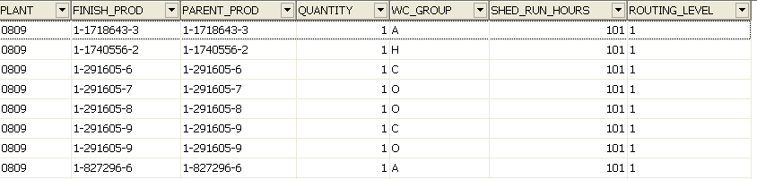
Results from mfg query – note that I did not have the ‘shed’ function so I commented out the code and defaulted it to 101.

